Slide 1
Are you ready to Paper Slide?
Notes:
Add intro on paper slide video

Slide 2
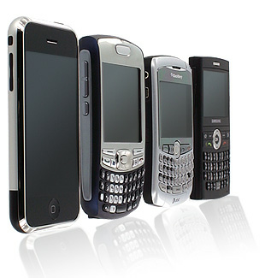
Low Tech meets High Tech
Camera
Paper
Markers

Slide 3
http://paperslide.wikispaces.com/PSV

Slide 4
Directions
Each Group Create One Page (slide) highlighting one of the following
1 reason teachers at your school should use DE
1 reason teachers at your school should use DE
1 reason teachers at your school should use DE
1 integration strategy- STEM
1 integration strategy- ELA
1 integration strategy- Arts
Each group sends one speaker to present their slide on the video

Slide 5
5 minutes to brainstorm
5 minutes to create slides
5 minutes to film

Slide 6
Examples
Solid Liquid Gas
Newton’s Law
Middle School Math
New Years Resolutions
Three Little Pigs
Why I’m flipping My Class

